Slide 1
NARMAs årskonferanse 2025, Lillestrøm
SWARMA’s organisation structure and principles

Slide 2
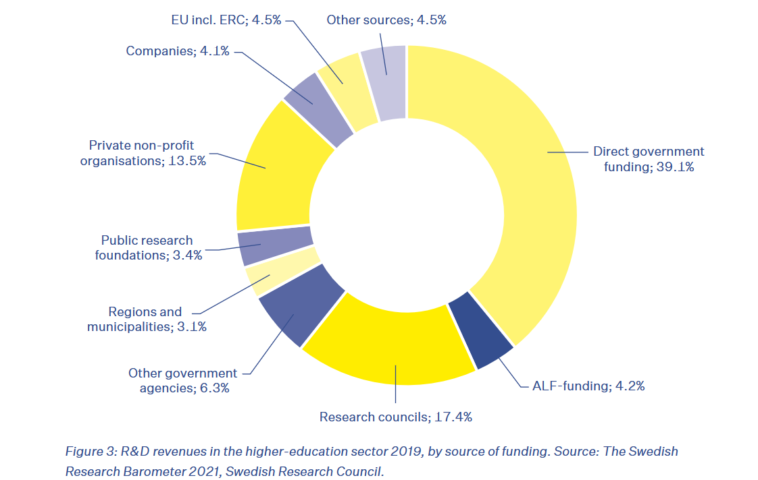
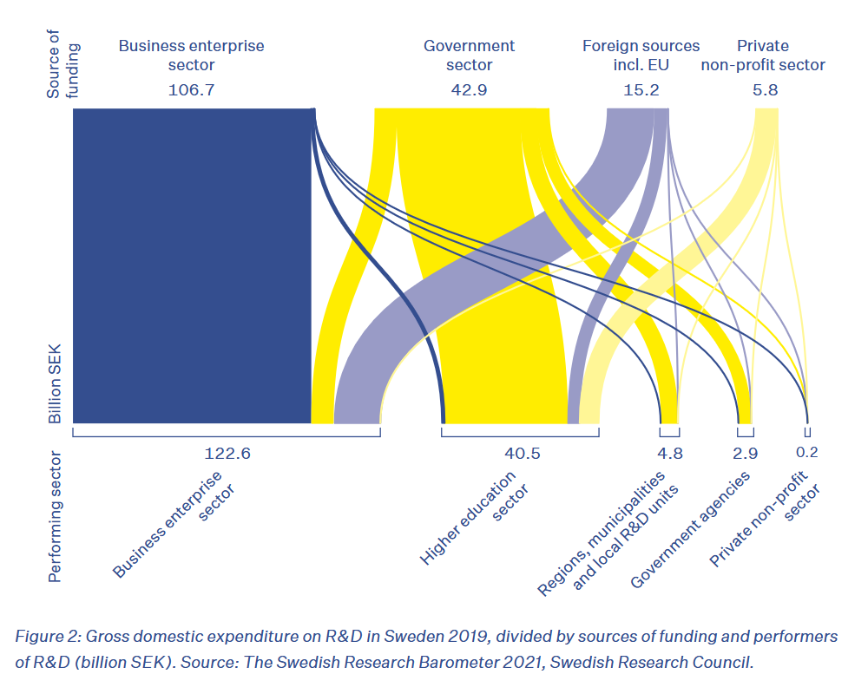
Swedish funding landscape

Slide 3
SWARMA: Purpose and aims
Promote the exchange of experiences between functions at Swedish higher education institutions that work with administrative support for external research funding
Assist in interpreting and implementing regulations from national and international funders
Work towards maintaining good relations with funders and national contact persons to quickly disseminate information to all higher education institutions
The goal is to strengthen and streamline the support for external research funding at Swedish higher education institutions
Initiated in 1994, and established in its current form in 2019
Notes:
1993 The EU/R&D Council is formed and an NCP organization is established. The EU/R&D Council also takes responsibility for the program committees.
1994 EU advisors/administrators at eight Swedish universities meet with the aim of exchanging experiences, contacts, and knowledge. This marks the beginning of the so-called EUFOU-nätverket. Thereafter, regular meetings are held 1-2 times a year, sometimes in Brussels.
1995 EARMA (The European Association of Research Managers and Administrators) is formed, with the same purpose as our network but at a European level.
2010 A parallel network for Swedish funding is created. Many are involved in both network.
2014 At the start of Horizon 2020, approximately 150 people are part of the EUFOU network and 75 people are part of the network for Swedish funding.
2018 A decision is made to merge the two networks
2019 SWARMA is formed!
2025 SWARMA consists of more than 460 participants from 34 member organisations

Slide 4
Organisation structure
SUHF (The Association of Swedish Higher Education Institutions
SWARMA
32 member organisations
Participants ~460
Steering group ~10
Election committee
Host univeristy
No member or participation fee!
No budget!
SUHF only!
Notes:
SUHF = 38 members. Members:
Swedish higher education institutions (SUHF) and their Grants Office or equivalent function.
No funders, research institutes or companies, etc. (SUHF only)
34 members organisations (March 2025)
Both large and) small higher education institutions, with varying organisational structures and degrees of specialisation
No members fee (only cost = website)
Participants:
~460 participants (March 2025)
Only employees at higher education institutions (not at funders, research institutes or companies)
Since the organisational structure of SWARMA’s participating organisations differs, it is up to each organisation to decide for themselves which employees can be included as participants in SWARMA.
Based on interest and voluntary work
Participants assist each other in interpreting and implementing regulations from national and international funders
Steering group
Appointed by the annual meeting (after nomination by a nomination committee)
~10 members representing the diversity within SWARMA in term of areas of interest, professional roles and the type and geographical location of the organisations within SWARMA
Planning and coordination
Budget
Planning of the network's internal and external collaborations
Communication tools
Handling incoming emails to the functional address, info@swarma.se
Newsletter
The network’s official website, http://www.swarma.se and LinkedIn group
Administering the election of representatives in the national reference groups for the European framework programs for research and innovation
Host University
Basically, cover cost and maintenance of website and functional address.

Slide 5
Activites and communication
Annual meeting (general assembly/årsmöte, digital)
Annual network meeting (organised by ~ 1 member organisation. ~ 150 participants. Employer cover the participation fee)
Webinars/seminars/workshops/meetings with funders etc.
Thematic subgroups (Ex. EU funding, US funding, Ethics)
Representatives in the national reference groups for Horizon Europe
Shared platform (Groups.io - the core of the network)
Swarma.se and LinkedIn
Info@swarma.se
Internal newsletter (~2-4/year)

