Slide 1
Research security
Anu Juslin
Finn-Arma, Tampere University

Slide 2
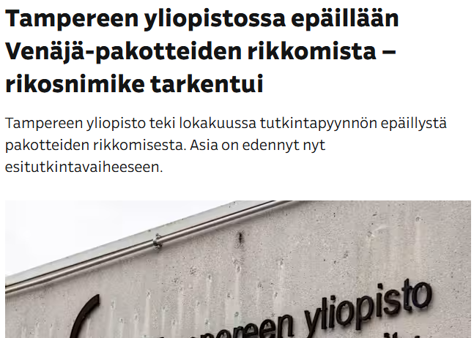
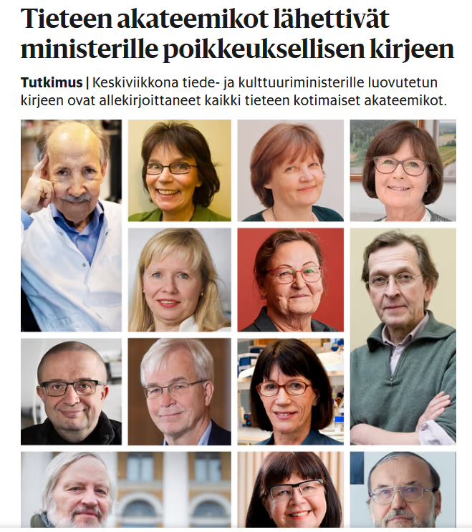
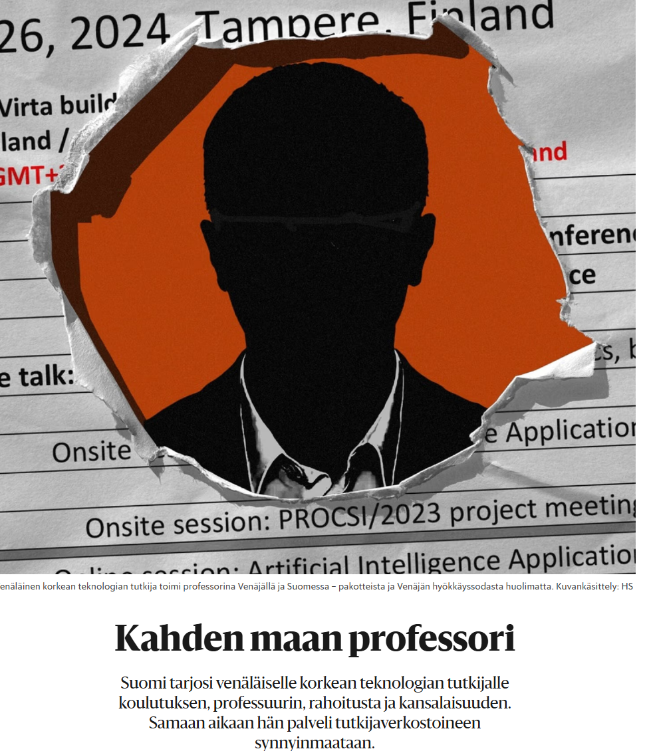
What?
Notes:
The changing geopolitical situation requires increasingly intense monitoring and responses with regard to research security. “safeguarding the research enterprise against the misappropriation of research and development to the detriment of national or economic security, related violations of research integrity, and foreign government interference.”

Slide 3
International sanctions, export controls, dual-use, security, …
Tampere University’s Know Your Partners group is responsible for developing the due diligence process related to the University’s partnerships in accordance with the principles of good governance to ensure that all proposed partners are thoroughly and carefully assessed before collaboration begins
Tampere University suspended all collaboration with organisations and institutions in Russia and Belarus
When using TUNI devices and services, it is important to consider the usage restrictions imposed by current sanctions. Actions contrary to these restrictions are against the usage rules and may even constitute a crime
Currently, there are sanctions in place against Russia, Belarus, Iran, Syria, North Korea, Myanmar, and Venezuela

Slide 4
What is the role of RMs? Who should be in charged?
Share your experiences
How we could collaborate in this matters?
How to learn from each other?

